Slide 1

Sorting
By: Anurag Ambuja

Slide 2
Sorting Algorithm
To arrange a set of items in sequence.
It is estimated that 25~50% of all computing power is used for sorting activities.
Most frequently used orders are numerical order and lexicographical order.
Possible reasons:
Many applications require sorting;
Many applications use inefficient sorting algorithms.
Sorting Applications
To prepare a list of student ID, names, and scores in a table
(sorted by ID or name) for easy checking.
To prepare a list of scores before letter grade assignment.
To produce a list of horses after a race (sorted by the finishing times) for payoff calculation.
To prepare an originally unsorted array for ordered binary searching.

Slide 3
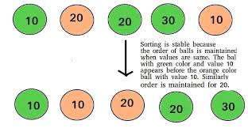
Classification:
Computational complexity
Memory usage
Recursion
Stability
General method: insertion, exchange, selection, merging, etc.
Whether the algorithm is serial or parallel. The remainder of this discussion almost exclusively concentrates upon serial algorithms and assumes serial operation.
Adaptability

Slide 4
Bubble Sort
Bubble sort examines the array from start to finish,
comparing elements as it goes.
Any time it finds a larger element before a smaller element,
it swaps the two.
In this way, the larger elements are passed towards the end.
The largest element of the array therefore "bubbles“
to the end of the array.
Then it repeats the process for the unsorted portion
of the array until the whole array is sorted.
Example: First Pass: ( 5 1 4 2 8 ) –> ( 1 5 4 2 8 ), Here, algorithm compares the first two elements, and swaps since 5 > 1

Slide 5
Before sorting | 14 | 2 | 10 | 5 | 1 | 3 | 17 | 7
outer=7, inner=0 | 2 | 14 | 10 | 5 | 1 | 3 | 17 | 7
outer=7, inner=1 | 2 | 10 | 14 | 5 | 1 | 3 | 17 | 7
outer=7, inner=2 | 2 | 10 | 5 | 14 | 1 | 3 | 17 | 7
outer=7, inner=3 | 2 | 10 | 5 | 1 | 14 | 3 | 17 | 7
outer=7, inner=4 | 2 | 10 | 5 | 1 | 3 | 14 | 17 | 7
outer=7, inner=6 | 2 | 10 | 5 | 1 | 3 | 14 | 7 | 17
outer=6, inner=1 | 2 | 5 | 10 | 1 | 3 | 14 | 7 | 17
outer=6, inner=2 | 2 | 5 | 1 | 10 | 3 | 14 | 7 | 17
outer=6, inner=3 | 2 | 5 | 1 | 3 | 10 | 14 | 7 | 17
outer=6, inner=5 | 2 | 5 | 1 | 3 | 10 | 7 | 14 | 17
outer=5, inner=1 | 2 | 1 | 5 | 3 | 10 | 7 | 14 | 17
outer=5, inner=2 | 2 | 1 | 3 | 5 | 10 | 7 | 14 | 17
outer=5, inner=4 | 2 | 1 | 3 | 5 | 7 | 10 | 14 | 17
outer=4, inner=0 | 1 | 2 | 3 | 5 | 7 | 10 | 14 | 17
---
outer=1, inner=0 | 1 | 2 | 3 | 5 | 7 | 10 | 14 | 17

Slide 6
Bubble Sort
Bubble sort works on the same general principle as shaking a soft drink bottle.
Right after shaking, the contents are a mixture of bubbles and soft drink, distributed randomly.
Because bubbles are lighter than the soft drink, they rise to the surface, displacing the soft drink downwards.
This is how bubble sort got its name, because the smaller elements "float" to the top, while the larger elements "sink" to the bottom.
Bubble sort is blissfully simplistic, as in it’s the simplest sorting algorithm. It earns that title by repeatedly iterating over your data structure, comparing pairs in adjacent spaces and swapping them throughout each iteration. It’s usually used as an intro to sorting algorithms, however, is quite popular in computer graphics because it can capture tiny swap errors.

Slide 7
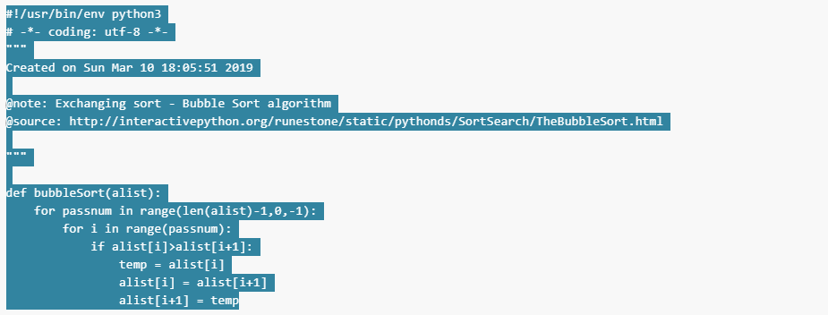
Python implementation:

Slide 8

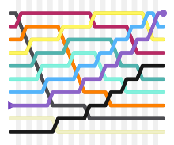
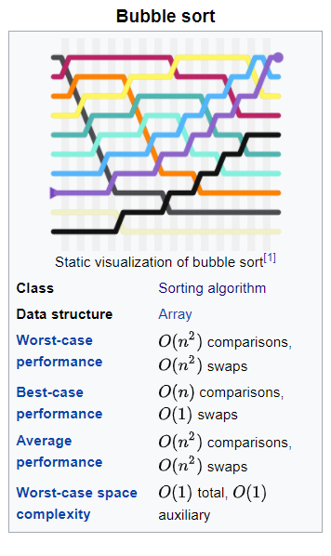

Slide 9
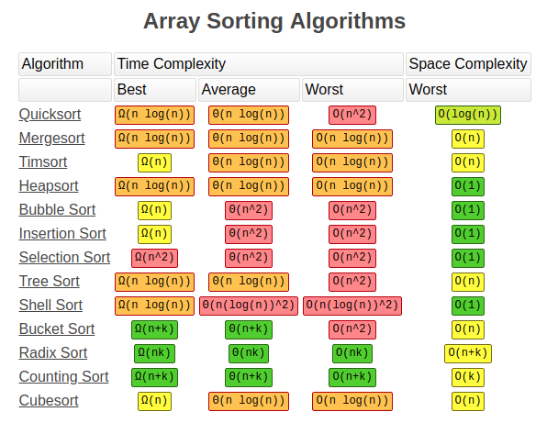

Slide 10


